Slide 1
Overview of Container Management
Wyn Van Devanter | @wynv
Notes:
- Intro, experience

Slide 2
Agenda
App Deployments
Containers
Clusters
Container Orchestration
Tool Overview
Container Management Systems

Slide 3
Why container management?
Building using containers is becoming the standard. Integral part of cloud architecture.
Brings new ways to deploy and manage software
Fosters standardized deployment platform
Notes:
- What is container management – start building using containers, new way of managing

Slide 4
What are containers?
Isolate an application, its dependencies and resource use into a standard unit of execution & deployment
Your application and everything it needs to run, with isolation benefits without the OS overhead
More portable, less resource use, more shippable…

Slide 5
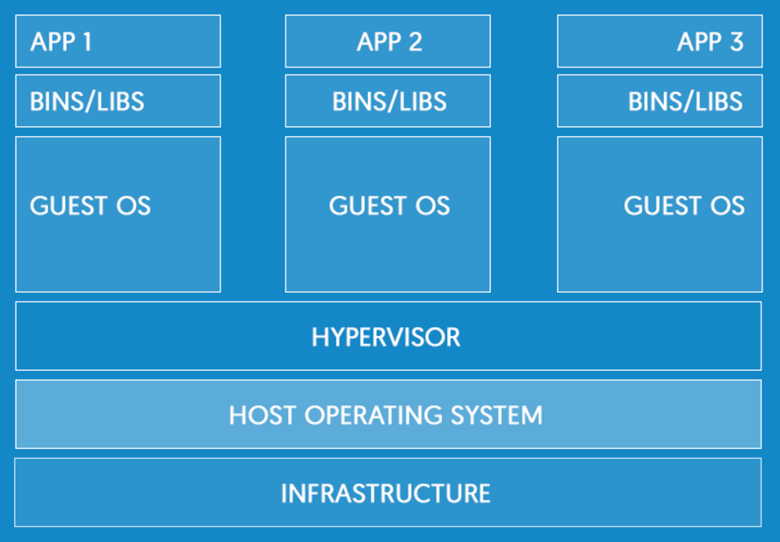
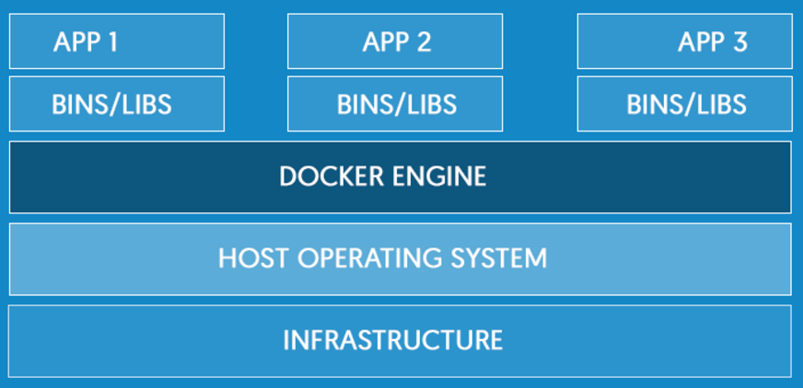
What are containers?
Virtual Machines
Containers

Slide 6
All the fuss about containers
Unprecedented consistency and portability for testing and shipping modern software applications
Docker makes containers easier
Orchestrators make groups of containers and apps easier
Container management systems make groups of groups of containers easier…

Slide 7
All these containers
Apps in Linux Containers, running against a Linux kernel, on a Linux server(s)
Apps in Windows Containers, running against a Windows kernel, on a Windows server(s)
Servers in AWS, servers in Azure
All containers, so all the same in some respects
Manage them all the same way, centrally

Slide 8
Clusters
Makes managing a pool of servers & their resources as simple as managing a single system
Typically for large scale, now container-based software deployment too
You don’t want to care much, about where containers run
With multiple container-based apps, a cluster is a way to standardized deployment

Slide 9
What is Container Orchestration?
Makes managing container-based applications across a cluster(s) easier
To give a 1) single development layer for developers; 2) a single platform for application deployment across clouds and 3) operationalized efficiency across the organization
Various distributed container management functionality

Slide 10
Container Infrastructure
Container Management System
Orchestrator
Container Engine
Containerized Applications
Security controls, image security scanning, centralized management tools, app lifecycle management, enterprise management
Scheduling, communication, service discovery, load balancing, self-healing, rolling updates, pipeline management, federation, etc
Runs containers
Application packaged in a standard way
Docker EE, OpenShift,
control plane
Cluster(s) managed by Kubernetes, Swarm, Mesos, Fleet
Docker on Azure/AWS/VM
App with React UI container, ASP.NET Core API container

Slide 11
Container Orchestration
Helps make the pieces in a distributed container system work together
Scheduling - placing a container on the right node
Cross-node communication
Service discovery
Scaling
Load balancing
Self-healing (automatic restarts)
Rolling updates
Service/App management (organizing containers that comprise a service, deployments)
Storage management

Slide 12
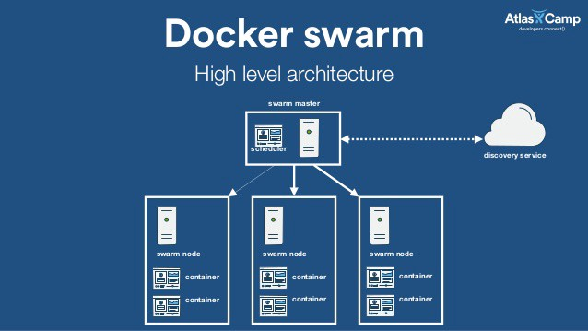

Slide 13
Container Orchestration

Slide 14
Orchestrators
Container Management System
Orchestrator
Container Engine
Containerized Applications
Security controls, image security scanning, centralized management tools, app lifecycle management, enterprise management
Scheduling, communication, service discovery, load balancing, self-healing, rolling updates, pipeline management, federation, etc
Runs containers
Application packaged in a standard way
Docker EE, OpenShift,
control plane
Cluster(s) managed by Kubernetes, Swarm, Mesos, Fleet
Docker on Azure/AWS/VM
App with React UI container, ASP.NET Core API container

Slide 15
Container Orchestration
Tools called orchestrators / schedulers
Kubernetes, Swarm, Mesos, Fleet, ECS
Manages containers across cluster(s)

Slide 16
Cluster of Nodes
Nodes (hosts) pool resources to form cluster
In a typical container-based environment, you would typically define that specific containers run on specified nodes, but that can be partially or fully managed.
The containers that comprise an application can move from node to node based on various conditions.
Any node can direct traffic to where the container(s) is being hosted.

Slide 17
Setting up an orchestrator
Number of nodes in a cluster
Specification & settings of the containers comprise your application or batch job
Resource usage
Other settings

Slide 18
Tool Overview – ECS, Kubernetes, Swarm, oh my (Mesos, Fleet, etc)
What kinds components are going into containers?
How do the components of the application talk to one another?
How is availability handled?
How is access control handled?
What sort of scalability is needed
How many applications am I planning to support?

Slide 19
Tool Overview - ECS
Hosted AWS service
Composes applications using:
Task definitions
Tasks
Services
Works with other AWS services such as ELB, elastic block storage, CloudWatch, VPC, CloudTrail
No support for infrastructure outside of EC2

Slide 20
Tool Overview - ECS
Capabilities:
Scheduling
Load balancing
Service Discovery
Service management - task definitions, tasks, services
Logging, Auditing
Storage

Slide 21
Tool Overview - ECS

Slide 22
Tool Overview - ECS

Slide 23
 | Elastic Container Service (ECS) | Azure Container Service (ACS)
 | Elastic Kubernetes Service (EKS) | Azure Kubernetes Service (AKS)

Slide 24
Tool Overview - Kubernetes
Google-spawned Kubernetes has quickly risen to dominate the container orchestration space
Heavyweights behind it including Red Hat, IBM
71% of major enterprises use Kubernetes
More focused on applications so plumbing is more set up for that
It can be harder to set up for other cases. More configurable but more complex.
Composes applications via pods – i.e. 1-5 containers making a service

Slide 25
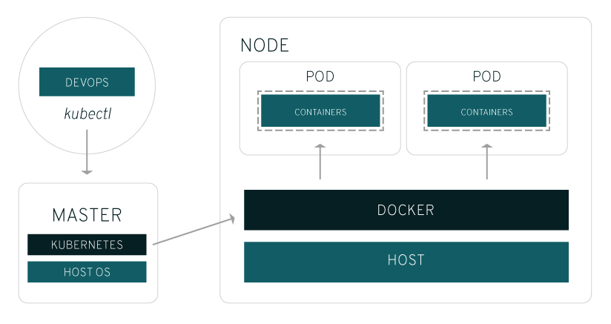
Tool Overview - Kubernetes
Source: Red Hat

Slide 26
Tool Overview - Kubernetes
Capabilities:
Scheduling
Cross-node communication
Service discovery
Scaling, autoscaling
Load balancing
Self-healing (automatic restarts)
Rolling updates

Slide 27
Tool Overview - Kubernetes
Advanced networking makes multi-host clusters much more easy to manage, at the expensive of slightly more complexity
Pods facilitates groups of containers that can communicate with each other as though they are running within the same system.
Allow applications running within the pod to interact in the same way they would as though they were not running in containers but simply running on the same physical host.

Slide 28
Kubernetes
Deployments
Services
Microservices

Slide 29
Tool Overview - Swarm
Swarm is more general purpose so setup decisions are left more open. But easy to get running.
Uses standard Docker API, so things like docker run work as usual
Tools like Compose can use Swarm without any changes.

Slide 30
Tool Overview - Kubernetes
Capabilities:
Scheduling
Cross-node communication
Service discovery
Scaling, autoscaling
Load balancing
Self-healing (automatic restarts)
Rolling updates

Slide 31
Container Management Systems
Container Management System
Orchestrator
Container Engine
Containerized Applications
Security controls, image security scanning, centralized management tools, app lifecycle management, enterprise management
Scheduling, communication, service discovery, load balancing, self-healing, rolling updates, pipeline management, federation, etc
Runs containers
Application packaged in a standard way
Docker EE, OpenShift,
control plane
Cluster(s) managed by Kubernetes, Swarm, Mesos, Fleet
Docker on Azure/AWS/VM
App with React UI container, ASP.NET Core API container

Slide 32
Container Management Systems
Control plane engineering
sits on top of the server nodes to help better management, uptime and performance across multiple clouds
creates a deployment that’s easily scaled
Run the same system on multiple, hybrid clouds

Slide 33
Container Management Systems
Enterprise-grade (Docker Enterprise, OpenShift)
Additional functionality, enterprise features, etc
More security scanning, secured images, centralized access control & management, networking, pipeline features (i.e. easy multiple environment setup), standardization, CaaS/PaaS functionality, cloud-based services, support

Slide 34
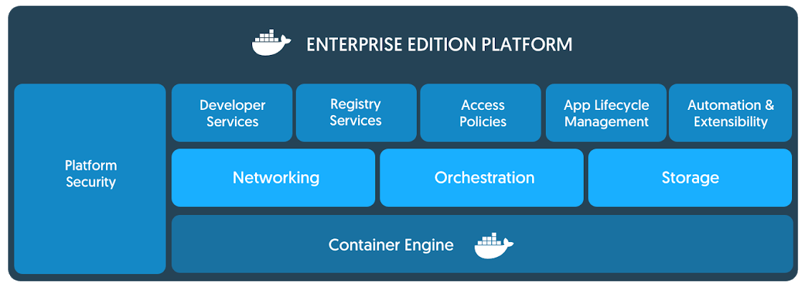
Docker EE

Slide 35
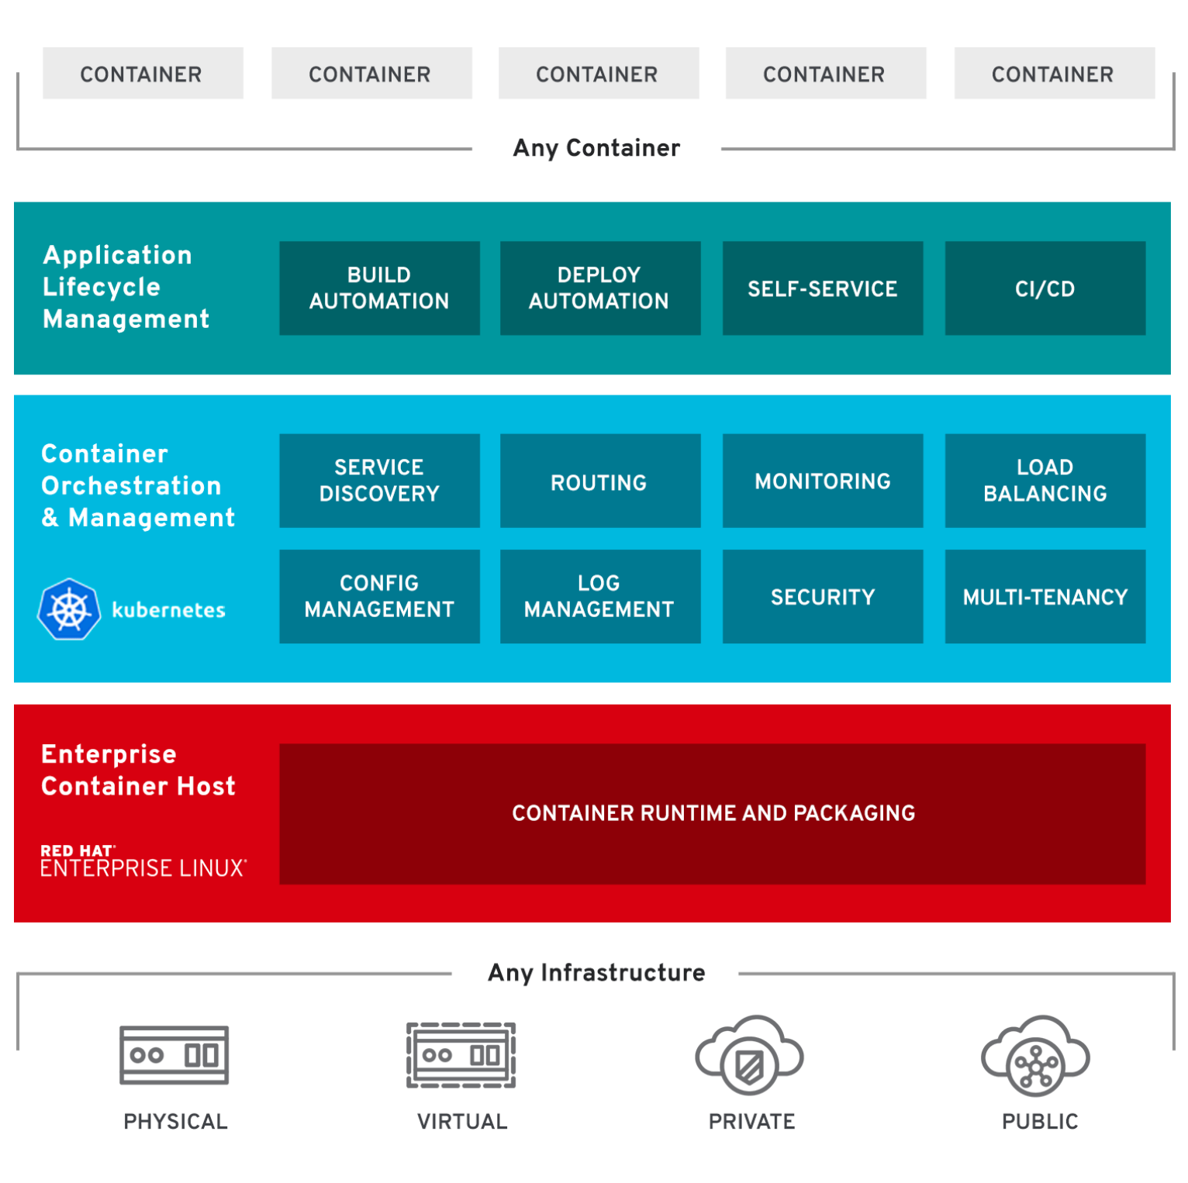
OpenShift

Slide 36
Azure and Docker
Docker on Azure, VMs, Docker EE certified infrastructure, OpenShift
Azure Container Service (ACS)
Azure Kubernetes Service (AKS)

Slide 37
Next Steps
@wynv | wyn.vandevanter@excella.com
Kubernetes Tutorial: Getting Started with Containers&Clusters, https://blog.codeship.com/getting-started-with-kubernetes/
Docker Swarm workshop, https://github.com/jpetazzo/container.training
Azure Kubernetes Service
Deploy ASP.NET Core app to Kubernetes on Google Kubernetes Engine, https://codelabs.developers.google.com/codelabs/cloud-kubernetes-aspnetcore

Slide 38
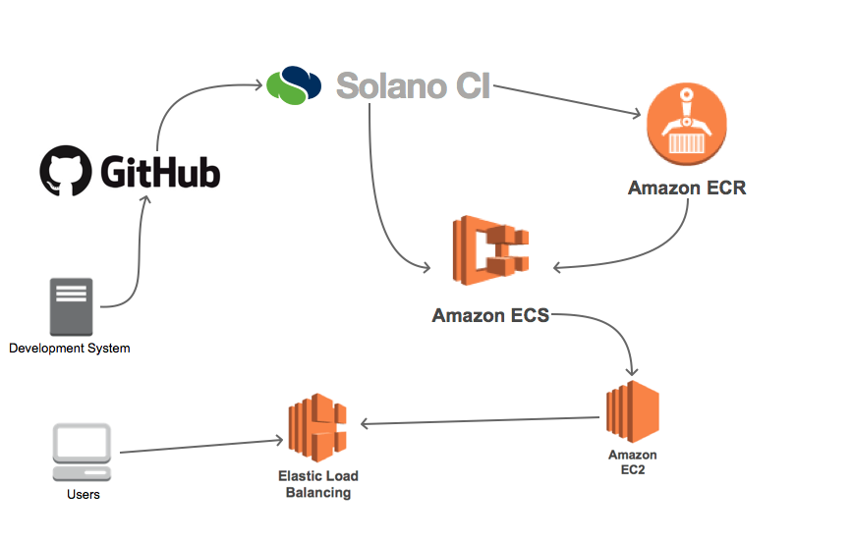
CI with

